Slide 1
What causes job satisfaction in Computer Science?
William Pembleton

Slide 2
Abstract
To be written at the end of the project

Slide 3
Abstract (cont.)
To be written at the end of the project

Slide 4
Background
This question is a supervised learning problem, meaning that I can use an algorithm like ID3.
Supervised learning solves problems that answer the question of why is my data like this

Slide 5
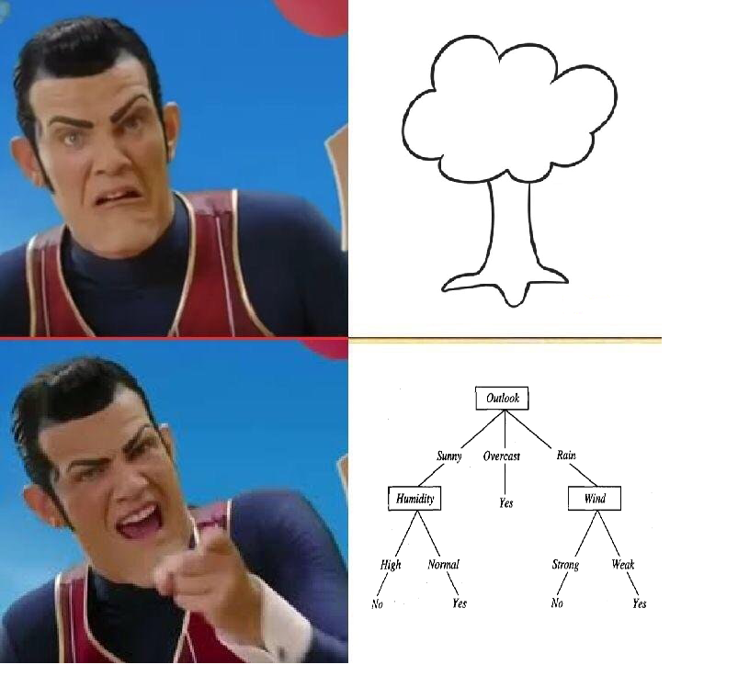
What’s ID3?
ID3 is a decision tree learning algorithm. It can take in a dataset and produce trees

Slide 6

Where’d I get my data from?
Stack Overflow is a Q&A website where developers can learn from each other
Every year they release a survey that asks developers question about their job

Slide 7
What do they ask about?
What kind of developer are you? (Full stack, back end, mobile)
How satisfied are you with your current job?
What languages do you use?
What IDE do you use?

Slide 8
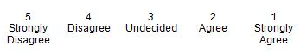
Methodological (Preprocessing)
Likert scale
For instance take a question like “Are you extremely satisfied with your current job?” The answers they gave answers similar to what’s above
I converted the answers the dataset gave into numeraical values so that if an answer is undecided I made it into a 3
Mostly did this to make the tree easier to read and easier to calculate averages later on

Slide 9
Methodological (Preprocessing)
They also asked questions like “Which of the following developer types describe you? Please select all that apply.”
The way Stack Overflow stored this is something like “Full Stack;Database Adminstrator;DevOps”
Separated each of these out into their own column
DevType.Full Stack | DevType.Database Adminstrator | DevType.Devops
Yes | Yes | Yes
Yes | No | Yes

Slide 10
Methodological (Preprocessing)
There were a few questions on the survey that asked participants to rank (for instance what benefits are important to you in a job) on a scale from 1-10
I coded this similar to the last slide Benefits.Industry
Lots of people didn’t answer this question so I made their values NaN

Slide 11
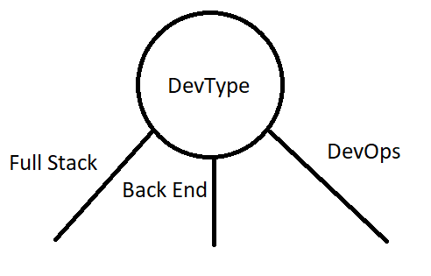
Methodological (Algorithm changes)
Within the code I took in stuff like DevType.FullStack and made it so that when the tree is asked to print itself it outputs something like the picture below

Slide 12
Methodological (Algorithm changes)
I added support for the Likert scale when a class is chosen that has a Likert scale for its values
Meaning that when you get to a leaf node it will tell you what it thinks your job satisfaction will be from 1-5
Another small change I made to the algorithm is allowing it to handle values of NaN (So I don’t have to throw away these rows)

Slide 13
Results (Job Satisfaction)
Imagine a very pretty tree

Slide 14
Results (Language)
Pretty tree #2

Slide 15
Results (Open Source)
Pretty tree #3

Slide 16
Results (Student)
I think get the idea

Slide 17
DevType
Desktop or enterprise applications developer;
Back End
FullStack;Back End; DevOps
FullStack;Database Manager
FullStack;Back End
Engineering Manager;Fullstack

